Slide 1


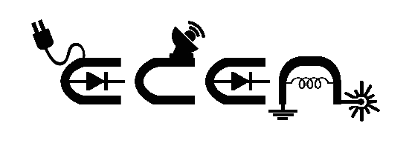


PSG COLLEGE OF TECHNOLOGY , COIMBATORE
ECE ASSOCIATION
PRESENTS
TENCHIX
AI-Powered Edge Computing Hardware for Welding Quality Defect Detection with Intelligent Voice Assistance
Team Name:XQUARTZ
Team Members
ABHINEETH K(22L203)
DARSHANA R(22L210)
NABUHAN N(22L237)

Slide 2

OVERVIEW
This project develops an AI-based Welding Quality Detection System using YOLO to classify welds as good, bad, or defective from images. It ensures accurate, real-time inspection with voice feedback, reducing human error and improving efficiency in quality control. The goal is to create an automated, real-time defect detection model that improves welding quality control, reduces manual inspection efforts, and ensures structural integrity in industrial applications.

Slide 3


BLOCK DIAGRAM
INTERFACE:
Raspberry Pi connected to a PC
OUTPUT :
The output is presented via both a visual display and a bilingual voice assistant(ENGLISH,TAMIL).
INPUT :
Welding images
OBJECT DETECTION:
Yolo v8 pre- trained models used for object detection and classification.
Percentage of Quality:
Prediction of quality of weld based on YOLO model.

Slide 4
PROPOSED METHODOLOGY
METHODOLOGY:
1.Input - Welding Images
Welding images are captured in real-time using an IP camera installed on a mobile phone or can be uploaded manually.
The images are sent to the Raspberry Pi via the IP address.
The images shown in Fig 2 and Fig 3 are collected from real-world welding samples, datasets (Kaggle), or synthetic data.
Preprocessing is performed:
Resize images to 640×640 for YOLO.
Apply normalization (scaling pixel values).
Convert to YOLO annotation format

Slide 5
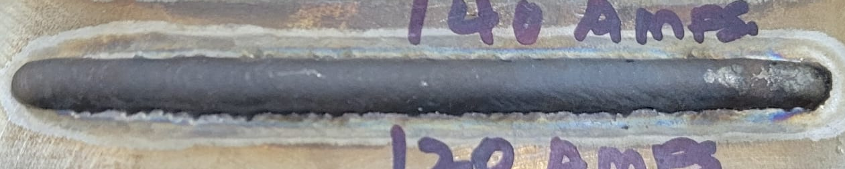
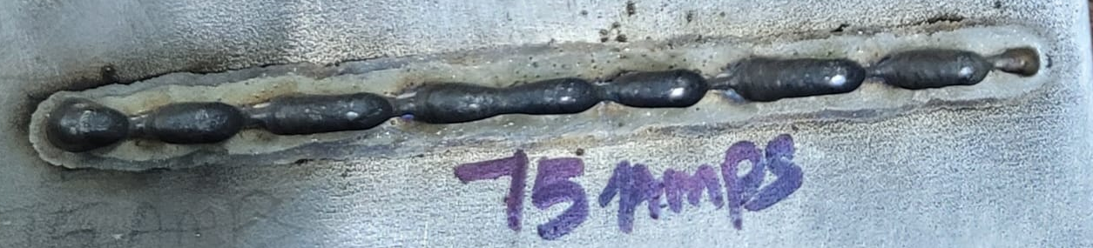
PROPOSED METHODOLOGY
Fig 2: Input Image - Bad Weld
Fig 3: Input Image - Good Weld

Slide 6
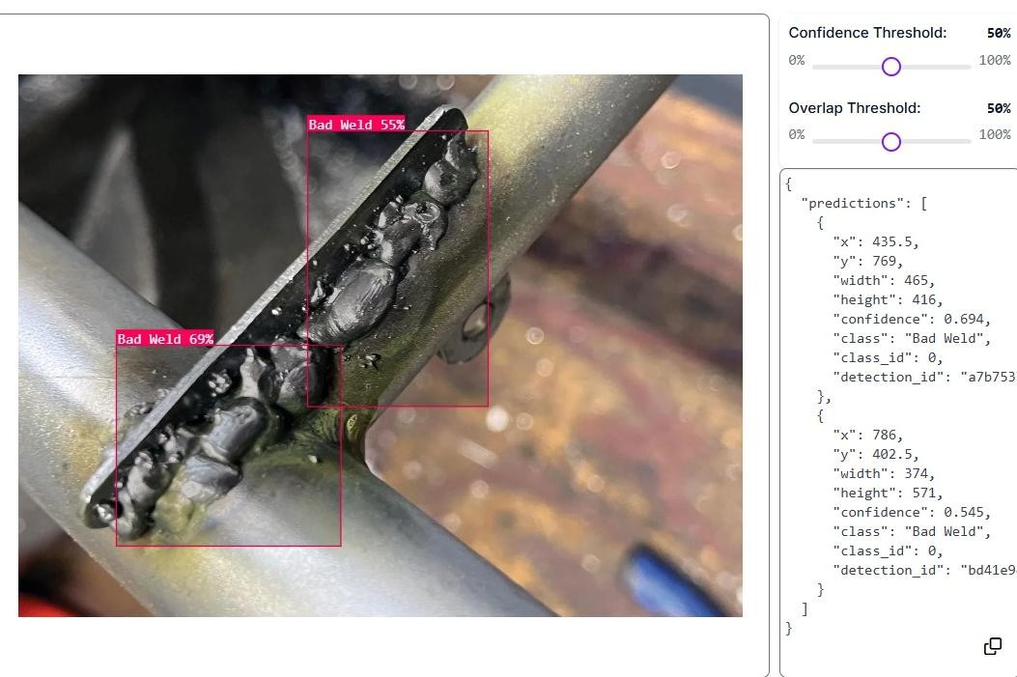
PROPOSED METHODOLOGY
2.Dataset Preparation in Roboflow:
Annotation: Manually label weld regions using bounding boxes.
Augmentation: Apply transformations like flipping, rotation, and brightness adjustments.
Format Conversion: Convert the dataset to YOLOv8-compatible format.
Export Dataset: Download the dataset and integrate it with the YOLO model and the model is trained using Roboflow as shown in the Fig 4.
Fig 4: Output obtained in Roboflow

Slide 7
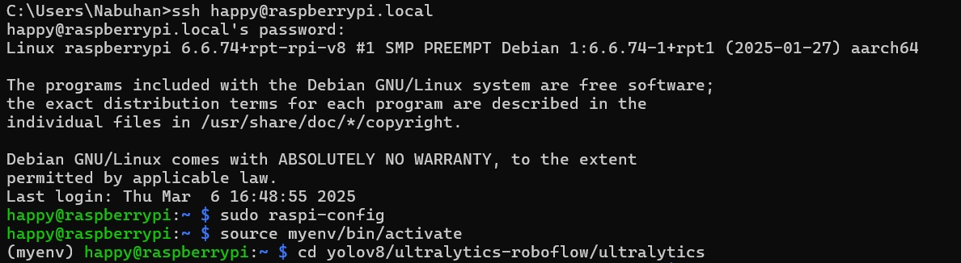
PROPOSED METHODOLOGY
3.Raspberry Pi Connected to a PC
The trained YOLO model (best.pt) is transferred to Raspberry Pi as shown in Fig.6.
Raspberry Pi is connected to a PC for setup and debugging.
Required dependencies are installed (torch, opencv, numpy).
A camera module or USB camera is connected to capture real-time image
Fig 5: Connecting raspberry pi to PC
Fig 6: Yolo model(best.pt) is dumped in Raspberry pi

Slide 8
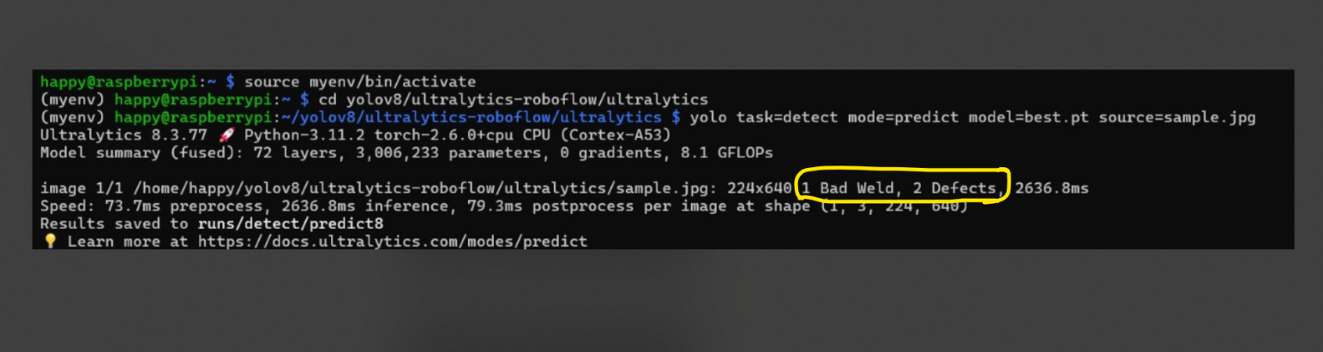
PROPOSED METHODOLOGY
4.Object Detection Using YOLOv8
YOLOv8 model is loaded onto Raspberry Pi.
The trained model detects and classifies welds into:
Good Weld (Fig 8)
Bad Weld (Fig 7)
Based on YOLO's confidence score, the quality of the weld is predicted.
The model calculates mAP (Mean Average Precision) to evaluate detection performance.
Fig 7: Output -Bad Weld

Slide 9
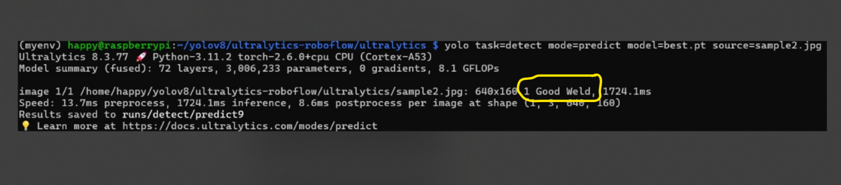
PROPOSED METHODOLOGY
Fig 8 :Output -Good Weld
5.AI-Assisted Voice Feedback
The AI-assisted voice feedback system enhances the usability of the welding quality detection system by providing real-time auditory feedback on the detected weld quality.
It is implemented using Text-to-Speech (TTS) technology, allowing users to receive the output in two languages (English & Tamil).

Slide 10
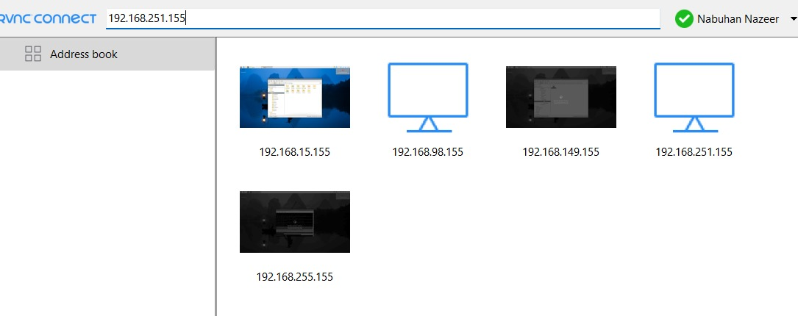
PROPOSED METHODOLOGY
6. Output Display Using VNC Window
The final detection result is displayed on the device (PC screen, Raspberry Pi display, or an external screen).For now the result is viewed on Raspberry Pi’s VNC Window (Fig 9).
The user can view:
Weld classification result.
Confidence scores.
Detected defect locations.
Optionally, alerts can be generated for defective welds.
Fig 9: Connecting to VNC

Slide 11
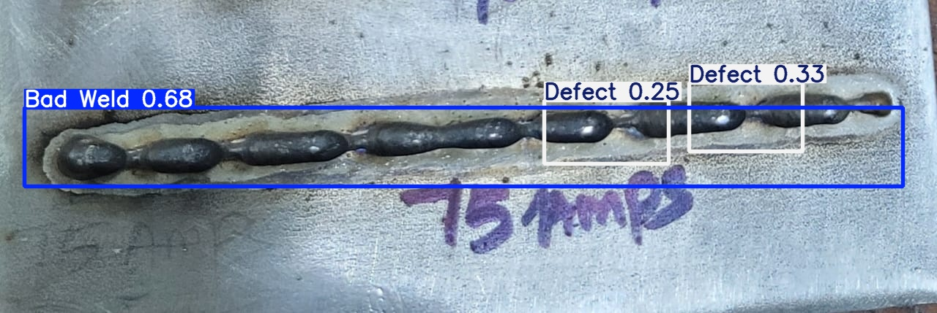
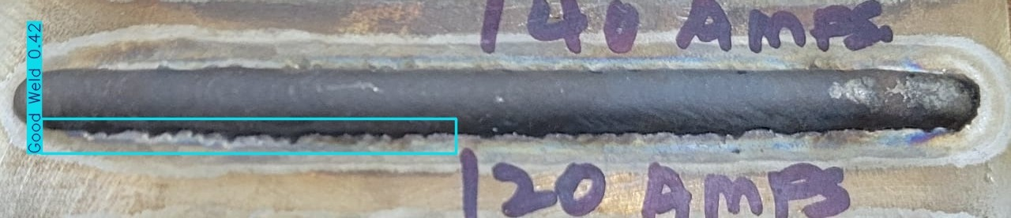
PROPOSED METHODOLOGY
RESULTS:
BAD WELDING OUTPUT
Fig 10 : Bad weld output obtained with real time sample
GOOD WELDING OUTPUT:
Fig 11 : Good weld output obtained with real time sample

Slide 12
FUTURE SCOPE
Expand Dataset: Include more diverse welding images and defect types to improve model generalization and accuracy.
Optimize Model for Edge Devices: Further optimize YOLOv8 using pruning and quantization for faster inference on Raspberry Pi.
Industrial Integration: Deploy the system on industrial welding machines for real-time monitoring and quality control.
Multi-Angle Defect Detection: Train the model on multi-angle welding images to detect defects from different perspectives.
Add Weld Type Recognition: Extend the system to recognize and classify different welding techniques (e.g., MIG, TIG).

Slide 13
REFERENCES
1.Chun-Hua Zhang, Li Di, Zeng An, "Welding Defect Detection Based on YOLOv8," Journal of Physics: Conference Series, vol. 446, pp. 371s-383s, 2024.
2.Sung Ho Ha and Sang Chan Park, "Application of data mining tools to hotel data mart on the intranet for database marketing", Expert system with application, vol. 15, pp. 1-31, 1998.
3. E. B. Martin, A. J. Morris and J. Zhang, "Process performance monitoring using multivariate statistical process control", IEE Proc-Control Theory Appl, vol. 143, no. 2, pp. 32s-44s, March 1996.
4. Adolfsson Stefan, Ali Bahrami, G. Bolmsjö and I. Claesson, "On-line quality monitoring in short-circuit gas metal arc welding", WELDING JOURNAL-NEW YORK, vol. 78, pp. 59, 1999.
5. T. Jayakumar, C. K. Mukhopadhyay, S. Venugopal, S. L. Mannan and Baldev Raj, "A review of the application of acoustic emission techniques for monitoring forming and grinding processes", Journal of materials processing technology 159, no. 1, pp. 48-61, 2005.

Slide 14
Thank you

